Slide 1



Pre-Entry Advice and Guidance
QUB Foundation Degree in Biological Sciences
UCAS APPLICATION REQUIRED

Slide 2
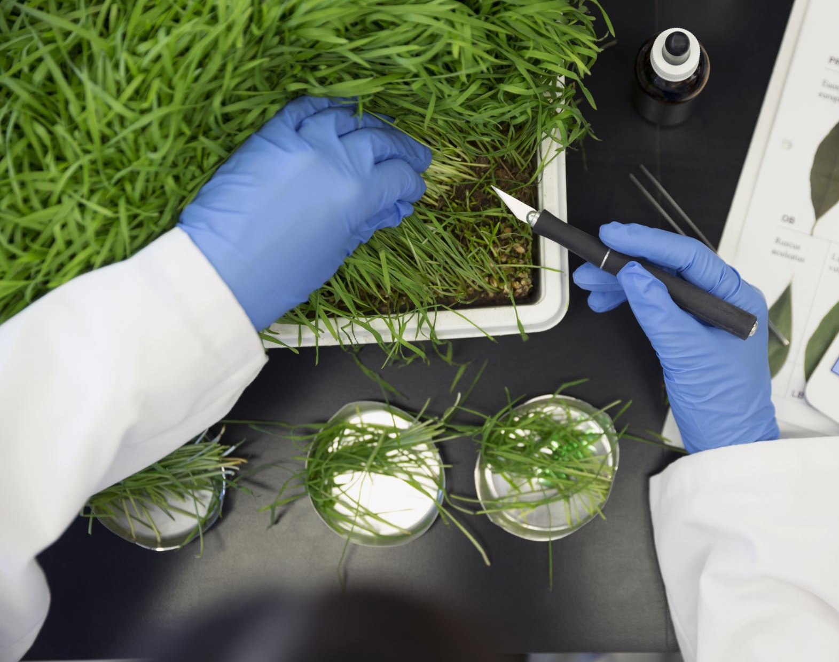

About this Pre-Entry Advice & Guidance
This guidance will you provide with:
  Course information – including what you will learn and how you will be assessed
  Course entry requirements
  Progression pathways – future learning and/or employment
  Your next steps
This guidance should help you decide if this is the right course for you.

Slide 3
About the FdSc in Biological Sciences
Level 7
Masters Degree
A Foundation Degree a is a Level 5 course and takes two years to complete.
It is broadly equivalent to the first two years of a degree.
Most students use this as an alternative route onto a BSc (Hons) – for example, degrees in the School of Biological Sciences at Queen’s University Belfast.
You will cover subjects like . . .
  Genetics & Molecular Biology
  Cell Biology & Biochemistry
  Biological Diversity & Evolution
  Ecology & Marine Biology
Level 6
Final Year of BSc (Hons)
Level 5
HND, FdSc, Yr 2 of BSc (Hons)
Level 4
HNC, Yr 1 of BSc (Hons)
Level 3
A-levels, Access, BTEC

Slide 4
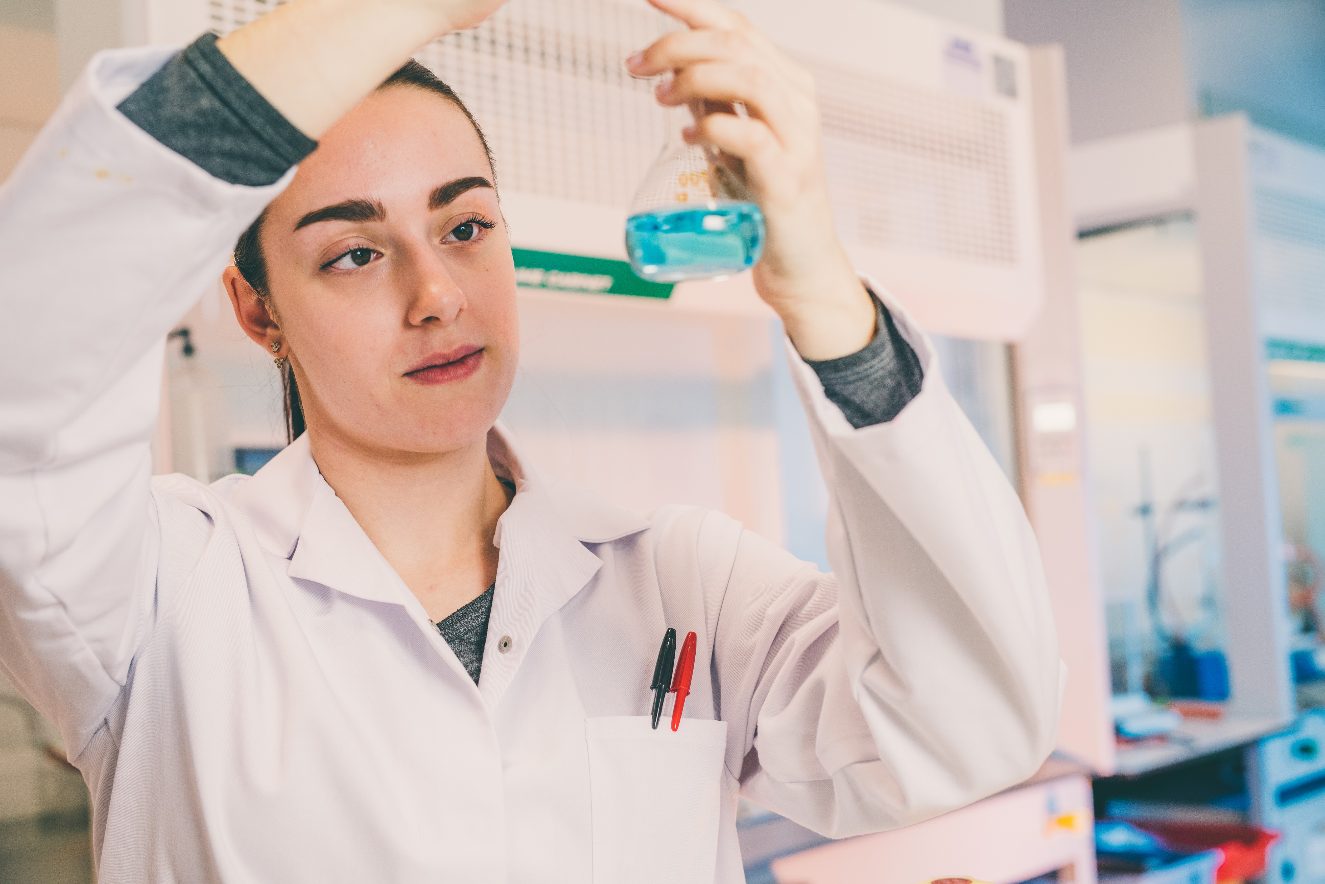
Why Choose a FdSc?
A good alternative for those who need another route into university – you’ll be studying the same material as those in the first year of a BSc (Hons)
At Belfast Met, we have smaller class sizes (20 vs. 200) which means more support in subjects you find tricky.
You will have access to laboratory facilities and equipment that would not be used in the first few years of a degree:
  HPLC, GC-MS, ¹H-NMR, FT-IR
  PCR, batch culture, confocal microscopy

Slide 5
Course Summary
Course Title: QUB Foundation Degree in Biological Sciences
Course Code: P00202
UCAS Code: C101
Duration: Two years full-time
Location: Belfast Met, Titanic Quarter Campus
Fees: £3155 per annum (fees are set by Queen’s University Belfast)
Entry Requirements: Minimum of CC at A-level (inc. A-level Biology) or MPP in BTEC Extended Diploma or Access Diploma PLUS GCSE Grade C in English and Mathematics or Essential Skills Literacy & Numeracy. See UCAS webpage for further details (click here)
UCAS Application Required

Slide 6
Course Content
Year One
Fundamentals of Science
Introductory Mathematics & Study Skills
Work-based Learning I
General Chemistry
General Biology
Biochemistry & Cell Biology
Year Two
Work-based Learning 2
Biological Diversity & Evolution
Microbiology
Genetics & Molecular Biology
Ecology
Environmental Science & Conservation or Chemistry of Organic Molecules*
Work-based Learning: You will need to undertake six weeks’ work placement between first and second year (this usually happens during June – August)
Those wishing to articulate to the BSc (Hons) Biochemistry at Queen’s University Belfast must take Chemistry of Organic Molecules
*

Slide 7

Options with a FdSc Biological Sciences
Other BSc (Hons)
Yr 2 /3 Entry
Employment
Postgraduate Study (MSc, PhD)
Graduate Entry Medicine
Graduate Entry Law
FdSc Biological Sciences
QUB BSc (Hons)
(Yr 2 Entry)
Direct Employment

Slide 8
Additional Information
Additional Support
Additional support is available for you in class and for exams if you have a confirmed disability, learning difficulty or long-term medical condition.
For example, extra time, a reader and/or a scribe.
Contact the Inclusive Learning Team to see what support is available.
You will also need to complete an LS1 Form at the start of the academic year.
Criminal Records
We promote equality of opportunity and welcome enrolments from a wide range of applicants, including those with criminal convictions.
To manage any risk, you MUST tell us about any unspent criminal convictions. For certain courses, you must disclose all criminal convictions.
To do this - complete a Criminal Offence(s) Disclosure Form or an Enhanced Criminal Offence(s) Disclosure Form. By disclosing criminal convictions you will not automatically be excluded from the application/ enrolment process.

Slide 9

Useful Contacts
Course Co-ordinator:
Iain McMenamin: IainMcMenamin@belfastmet.ac.uk
School Administrator:
Lauren Fetherston: LFetherston@belfastmet.ac.uk
Course enquiries:
Tel 028 90265 265 Option 2
Application related enquiries:
Tel 028 90265 265 Option 3
Other queries:
Tel 9026 5000
Useful Links
Belfast Met Website
Life at the Met
Public Documents
Student Criminal Disclosures
Student Support Services
Belfast Met Passport

Slide 10
Your Next Steps ...
Need some more information: Check out our website and follow us on social media for details of our Open Days and Information Events.
Ready to Apply: Apply Now – UCAS FdSc Biological Sciences

